Slide 1
Multivariate quantitative genetics

Slide 2
A quick recap…
Individuals vary at some phenotypic trait
Variation in complex traits comes from genetic and environmental effects
Genetic variation depends on allele (and genotype) frequencies at an unknown set of loci.
The relationship between alleles and genetic variation in a trait is complicated
We might start by estimating h² and progress to trying to genetically map a trait.

Slide 3

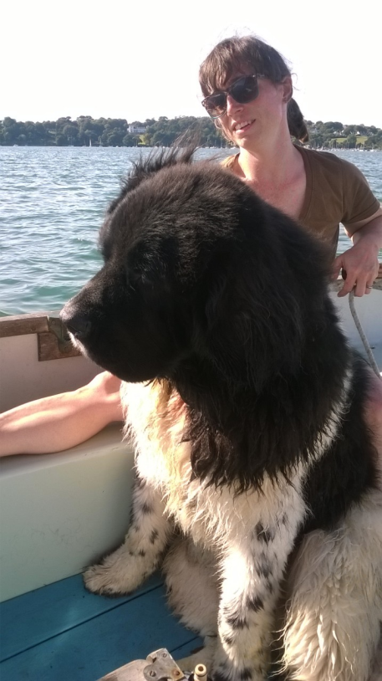
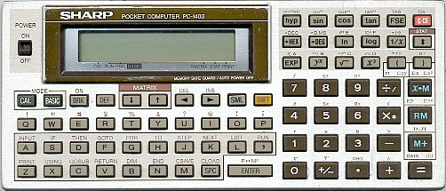


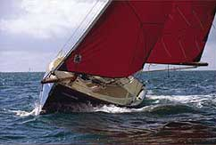

A quick recap…
1985
2015

Slide 4
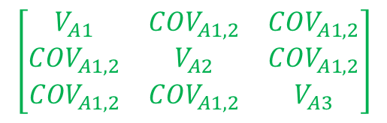
A quick recap…
1985
2015
$$\left[\begin{matrix}V_{A1} & {COV}_{A1,2} & {COV}_{A1,2} \\ COV_{A1,2} & V_{A2} & {COV}_{A1,2} \\ {COV}_{A1,2} & {COV}_{A1,2} & V_{A3}\end{matrix}\right]$$
G

Slide 5
A quick recap…
Individuals vary at lots of phenotypic traits!
Often different traits covary

Slide 6
Covariance
Associations between traits measured by ‘covariances’
amount of shared variation between two factors
degree (and direction) of shared deviations from the mean
Positive deviations in x tend to be found with positive deviations in y = positive covariance
Positive deviations in x tend to be found with negative deviations in y = negative covariance

Slide 7
Covariance = 0
bivariate mean
–,+
+,+
Trait 2
–,–
+,–
Trait 1
No association between trait 1 and trait 2
Phenotypic covariance = 0

Slide 8
Covariance > 0
bivariate mean
+,+
–,+
Trait 2
+,–
–,–
Trait 1
Positive association between trait 1 and trait 2
Phenotypic covariance > 0

Slide 9
Covariance < 0
bivariate mean
–,+
+,+
Trait 2
–,–
+,–
Trait 1
Negative association between trait 1 and trait 2
Phenotypic covariance < 0

Slide 10
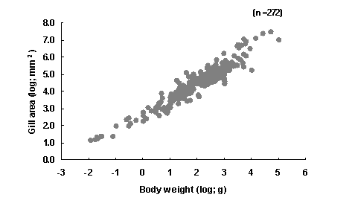

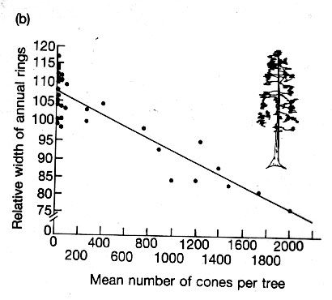

Slide 11
Correlations
Traits are measured on ‘arbitrary’ scales
variance depends on what units/scale we use
variances given in squared units (e.g., mg²)
Therefore, covariances depend on the scale of the two traits being examined
e.g., cov between body size & arm length in kg*cm units
Can remove units by dividing covariance by product of the standard deviations of the traits
Correlation used as a standardised measure of covariance

Slide 12
Where does covariance come from?
y_{i} = µ + g_{i} + e_{i}
V_{P} = V_{G} + V_{E}

Slide 13
Where does covariance come from?
y_{1i} = µ₁ + g_{1i} + e_{1i}
y_{2i} = µ₂ + g_{2i} + e_{2i}
V_{P1} = V_{G1} + V_{E1}
V_{P2} = V_{G2} + V_{E2}
COV_{P(1,2)} = COV_{G(1,2)} + COV_{E(1,2)}

Slide 14
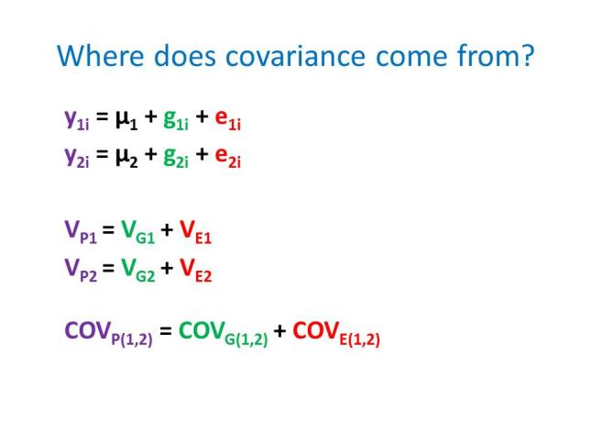
Often presented as a genetic correlation:
r_{G} = COV_{G} /(V_{G1}.V_{G2})^{0.5}

Slide 15
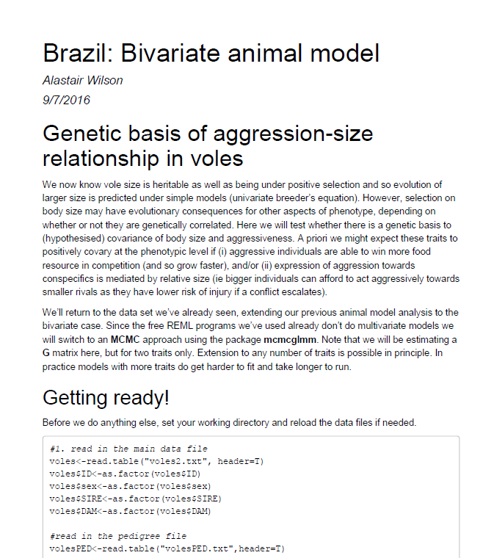
Normally estimate additive genetic correlation:
r_{G} = COV_{A} /(V_{A1}.V_{A2})^{0.5}
Statistical methods to estimate V_{A} for one trait can be extended to the multivariate case, estimating genetic variance for, and covariance between, multiple trait.

Slide 16
Often presented as a genetic correlation:
r_{G} = COV_{G} /(V_{G1}.V_{G2})^{0.5}
Trait 2
Trait 1

Slide 17
Often presented as a genetic correlation:
r_{G} = COV_{G} /(V_{G1}.V_{G2})^{0.5}
r_{G} > 0
Trait 2
Genetic relationship similar to that seen in phenotypes overall.
Trait 1

Slide 18
Often presented as a genetic correlation:
r_{G} = COV_{G} /(V_{G1}.V_{G2})^{0.5}
r_{G} = 0
Trait 2
No genetic relationship. Phenotypic relationship due to environmental effects alone.
Trait 1

Slide 19
Often presented as a genetic correlation:
r_{G} = COV_{G} /(V_{G1}.V_{G2})^{0.5}
r_{G} < 0
Trait 2
Negative genetic relationship masked by positive environmental relationship that dominates phenotypic pattern.
Trait 1

Slide 20
Why is genetic covariance important?
Genetically correlated traits will not respond independently to selection.
Selecting on one trait, will cause correlated responses in a correlated trait.
Natural selection does not act on single traits in isolation, fitness depends on multivariate phenotype
Multivariate phenotypic evolution depends on selection and genetic (co)variance.
Genetic (co)variance impacts the direction and rate of evolution, and can constrain adaptation.

Slide 21
What’s happening with the genes here?

Slide 22
Linkage disequilibrium
As a source of genetic correlation between traits
If one locus only affects trait X (a_{X}) and another locus only affects trait Y (a_{Y}), then LD creates a genetic association between traits

Slide 23
Linkage disequilibrium
We generally tend to ignore LD as a source of associations between traits, why?
LD decays rapidly because of recombination
D erodes at a rate proportional to the rate of recombination (c)
So unless selection keeps recreating an association, recombination will remove one

Slide 24
Pleiotropy
One locus affects more than one trait
Causes, e.g.
Same gene expressed in different tissues
Shared developmental basis
Physical interactions (muscle on bone, tissue fields)
Causal, where trait 1 causes trait 2, like high resting metabolic rate and body weight
Autocorrelation (like height at year 1 and height at year 2)

Slide 25
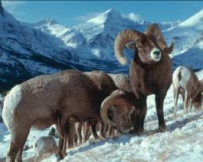
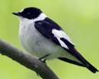
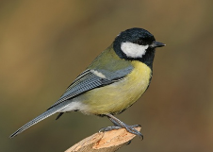

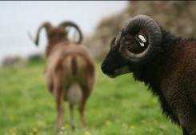
Life history trade-offs
Allocation to survival
Allocation to Reproduction
At equilibrium, segregating genetic variance is antagonistic for survival and reproduction (i.e. r_{G} < 0)
Negative r_{G} imposes evolutionary constraint because little genetic variation in the direction favoured by selection
Notes:
But if evolutionary ecology as a whole is being a bit slow to embrace a fully multivariate view of phenotypic evolution and constraint, it does have a long tradition of applying a bivariate view which is encapsulated in the idea of a trade-off between life history traits, or fitness components – for example reproduction and survival.
The idea here is that any individual in a population has to decide how to allocate a fixed resource between two competing demands, for instance somatic maintenance and hence survival, versus reproductive investment. We can imagine a trade-off function – in this case just a straight line – along which different allocation strategies yield similar expected fitness. With no single strategy better than the others, at equilibrium we might expect genetic variance to persist in the direction of this trade-off function. In other words we expect a negative genetic covariance – or correlation – between the traits in the trade-off – in this case survival and reproduction.

Slide 26
Life history trade-offs
Allocation to survival
Based on van Noordwijk & de Jong 1986
High resource
Allocation to Reproduction
But what is food resources are variable, adds V_{E} to each trait and positive COV_{E}. If you get more food you can allocate more to both traits.
r_{P} may be positive, but r_{G}<0 still imposes constraint.
Notes:
Now despite this expectation of negative genetic correlation we often find positive phenotypic correlations among fitness related traits in a population individuals in a population. In fact this isn’t unexpected if environmental heterogeneity generates variance in the amount of resource individuals have available.
So you can see in this illustration that individuals – or genotypes – are all lying on the same trade-off function, but ones that find themselves in a high higher resource environment are able to allocate more to both traits. So we are still postulating that there is a negative genetic correlation acting as an evolutionary constraint here, but that there could be a positive phenotypic correlation.

Slide 27
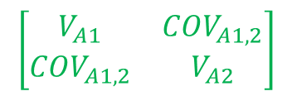
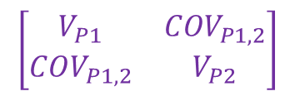
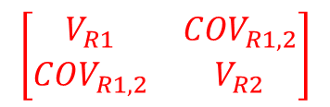
But focussing on two traits at a time is also limiting. How can we work with bigger sets of traits?
Yes, but need to start thinking in terms of matrices!
$$\left[\begin{matrix}V_{P1} & {COV}_{P1,2} \\ COV_{P1,2} & V_{P2}\end{matrix}\right]$$
$$\left[\begin{matrix}V_{A1} & {COV}_{A1,2} \\ COV_{A1,2} & V_{A2}\end{matrix}\right]$$
$$\left[\begin{matrix}V_{R1} & {COV}_{R1,2} \\ COV_{R1,2} & V_{R2}\end{matrix}\right]$$
=
+
P
=
G
+
R

Slide 28

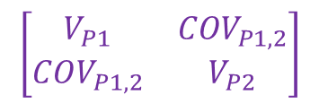
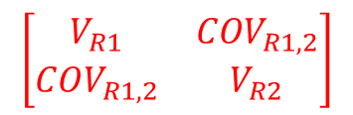
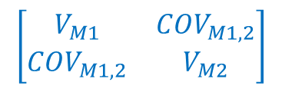
But focussing on two traits at a time is also limiting. How can we work with bigger sets of traits?
Can make more partitions for multivariate traits too.
$$\left[\begin{matrix}V_{P1} & {COV}_{P1,2} \\ COV_{P1,2} & V_{P2}\end{matrix}\right]$$
$$\left[\begin{matrix}V_{A1} & {COV}_{A1,2} \\ COV_{A1,2} & V_{A2}\end{matrix}\right]$$
$$\left[\begin{matrix}V_{M1} & {COV}_{M1,2} \\ COV_{M1,2} & V_{M2}\end{matrix}\right]$$
$$\left[\begin{matrix}V_{R1} & {COV}_{R1,2} \\ COV_{R1,2} & V_{R2}\end{matrix}\right]$$
=
+
+
P
=
M
G
+
+
R

Slide 29
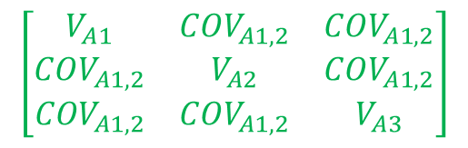
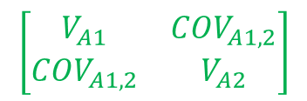
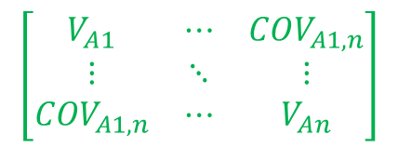
G matrix can be any size you want
$$\left[\begin{matrix}V_{A1} & {COV}_{A1,2} \\ COV_{A1,2} & V_{A2}\end{matrix}\right]$$
2 traits
$$\left[\begin{matrix}V_{A1} & {COV}_{A1,2} & {COV}_{A1,2} \\ COV_{A1,2} & V_{A2} & {COV}_{A1,2} \\ {COV}_{A1,2} & {COV}_{A1,2} & V_{A3}\end{matrix}\right]$$
3 traits
$$\left[\begin{matrix}V_{A1} & ⋯ & {COV}_{A1,n} \\ ⋮ & ⋱ & ⋮ \\ {COV}_{A1,n} & ⋯ & V_{An}\end{matrix}\right]$$
n traits

Slide 30
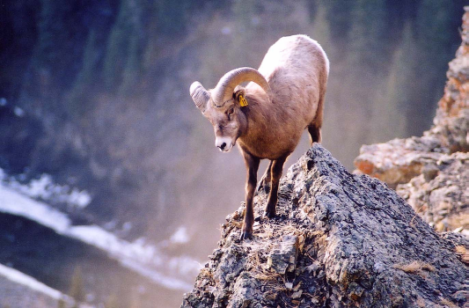
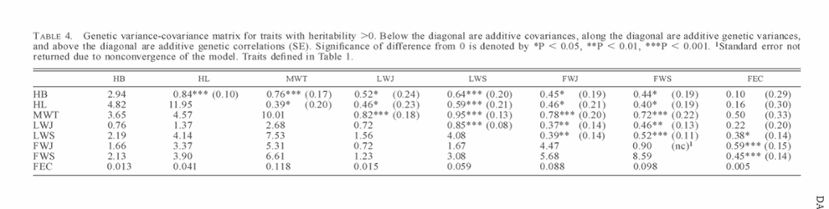
Coltman et al. Evolution 2005
Precision of r_{G} estimates much lower than h²
Large SE's on genetic correlations

Slide 31
G matrix can be any size you want
$$\left[\begin{matrix}V_{A1} & {COV}_{A1,2} \\ COV_{A1,2} & V_{A2}\end{matrix}\right]$$
2 traits
Why?
Use G to predict multivariate selection responses (use multivariate breeders equation)
Study the structure of G to test important evolutionary hypotheses
$$\left[\begin{matrix}V_{A1} & {COV}_{A1,2} & {COV}_{A1,2} \\ COV_{A1,2} & V_{A2} & {COV}_{A1,2} \\ {COV}_{A1,2} & {COV}_{A1,2} & V_{A3}\end{matrix}\right]$$
3 traits
$$\left[\begin{matrix}V_{A1} & ⋯ & {COV}_{A1,n} \\ ⋮ & ⋱ & ⋮ \\ {COV}_{A1,n} & ⋯ & V_{An}\end{matrix}\right]$$
n traits

Slide 33
Multivariate breeders’ equation
Univariate R = h²S becomes:
Δz = G ß
Vector of selection gradients (Lande & Arnold 1983. Evolution)
Vector of changes to trait means

Slide 34
Multivariate breeders equation
Univariate R = h²S becomes:
Δz = G ß
Square n_{x}n matrix of genetic variances and covariances for n traits
V_{A.1} COV_{A.12} . . . COV_{A.1n}
COV_{A.12} V_{A.2} . . . COV_{A.2n}
. . .
COV_{A.1n} COV_{A.2n} . . . V_{A.n}
G =
. . .
. . .
. . .
. . .

Slide 35
Multivariate Breeders’ Equation
Δz = G ß
Direct response to selection
Correlated response to selection
Notes:
The univariate breeders equation is highly predictive under artificial selection in the lab. Which is not that surprising because artificial selection makes sure that all the dynamics are governed by this term. Of course the trait is still likely to genetically covary with other traits, but this second (natural) selection gradient is expected to be small compared to beta1. In the field however, the univariate breeders equation has failed to be predictive, and I think its commonly believed that this has to be part of the reason. A) were measuring these selection gradients incorrectly by ignoring correlated traits that are under selection, and we are also not accounting for evolution that occurs because the trait is getting dragged along with other traits with which it I s genetically correlated.

Slide 36
TRAIT 1 = Egg size
TRAIT 2 = Egg number
both under positive selection
R₁
R₂
=
3 0
0 4
0.20
0.18
=
0.60
0.72
r_{G} = COV_{A} = 0
√V_{A1}√V_{A2}
R₁
R₂
=
3 1.2
1.2 4
0.20
0.18
=
0.82
0.96
r_{G} = + 0.35
R₁
R₂
=
3 -2.95
-2.95 4
0.20
0.18
=
0.07
0.13
r_{G} = -0.85

Slide 37
Genetic constraints may not be apparent from r_{G} among pairs of traits
What is the “effective” dimensionality of G
Is it less that the number of traits n?
Use matrix decomposition methods (e.g., eigen vector analysis, PCA)
***See e.g. Blows 2006. A tale of two matrices: multivariate approaches in evolutionary biology. Journal of Evolutionary Biology***

